Slide 1

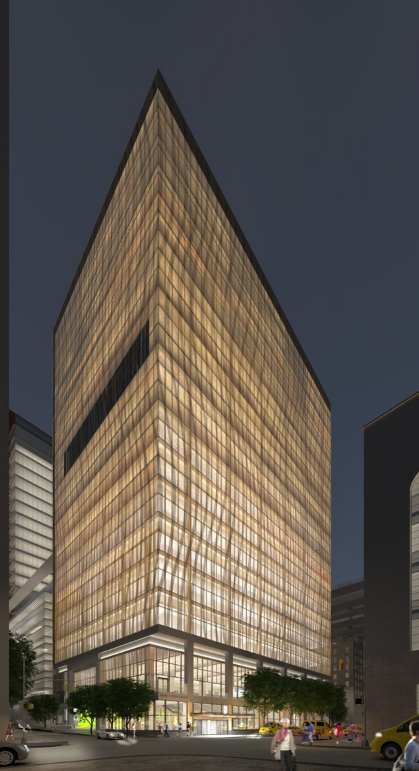

Radiation techniques and technology: relevance to immuno-radiotherapy of pancreatic cancer
Silvia C Formenti, MD
Weill Cornell Medicine, New York, NY

Slide 2
Disclosure Information
I have the following relevant financial relationships to disclose:
Consultant for: Bayer, Bristol Myers Squibb, Varian, ViewRay, Elekta, Janssen, Regeneron, GlaxoSmithKline, Eisai, AstraZeneca, Merck US, EMD Serono/Merck, Genentech/ROCHE, Boehringer Ingelheim, Accuray
Grant/research support from: Bristol Myers Squibb, Varian, Regeneron, Merck, Celldex, Arcus
Notes:
We originally introduced the concept of radiation as a tool to inflame the irradiated tumor, induce immunogenic cell death and elicit both immunestimulatory and immunospressive signals sensed by the host immune system.
In rare cases immunestimulatory effects prevail to enable a cancer specific immune response capable to contribute to the in field response, and through immunological memory evoke responses outside the field, either sustaining dormancy or in rare cases indicing abscopal responses in unirradiated metastasis

Slide 3

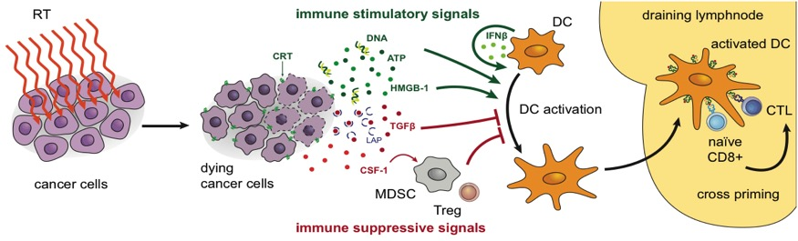


Radiotherapy to convert the tumor into an “in situ” vaccine
Out of field,
distant sites
IJROBP, 2004, 2005
IJROBP, 2012
Notes:
Our story of converging RT with IT started by recognizing the immunogenic nature of the abscopal effect.
RT then acquired and other R that of “immune Rejection”, and we and other spend the past 20 years trying to
describe the main mechanisms of RT-Induced immune rejection.

Slide 4
Shifting the balance of RT immunosuppressive versus pro-immunogenic signals
CTLA-4 blockade
Formenti SC, et al. Nat Med 2018;24:1845–51
TGFβ blockade
Formenti SC, et al. Clin Cancer Res 2018;24:2493–504
CD73 blockade/adenosine
Wennerberg E, et al. Cancer Immunol Res 2020;8:465–78
VISTA blockade
Pilones KA, et al. Oncoimmunology 2020;9:1830524
Activin blockade
De Martino M, et al. Cancer Immunol Res 2021;9:89–102
TLR agonists
Dewan MZ, et al. Clin Cancer Res 2012;18:6668–78
DC growth factors (Flt3L, GM-CSF)
Demaria S, et al. Int J Radiat Oncol Biol Phys 2004;58:862–70
Golden EB, et al. Lancet Oncol 2015;16:795–803
IFN inducers
Vanpouille-Box C, et al. Nat Commun 2017;8:15618
Formenti SC, et al. Nat Med 2018;24:1845–51
IL-15
Pilones KA, et al. Cancer Immunol Res 2020;8:1054–63
CTLA-4, cytotoxic T lymphocyte-associated antigen-4; DC, dendritic cell; Flt3L, Flt3-Ligand; GM-CSF, granulocyte-macrophage colony-stimulating factor; IFN, interferon; IL-15, interleukin-15; PD-L1, programmed cell death ligand-1; RT, radiotherapy; TGFβ, transforming growth factor beta; TLR, toll-like receptor; VISTA, V-set immunoregulatory receptor
J Natl Cancer Inst 2013;105:256–265

Slide 5
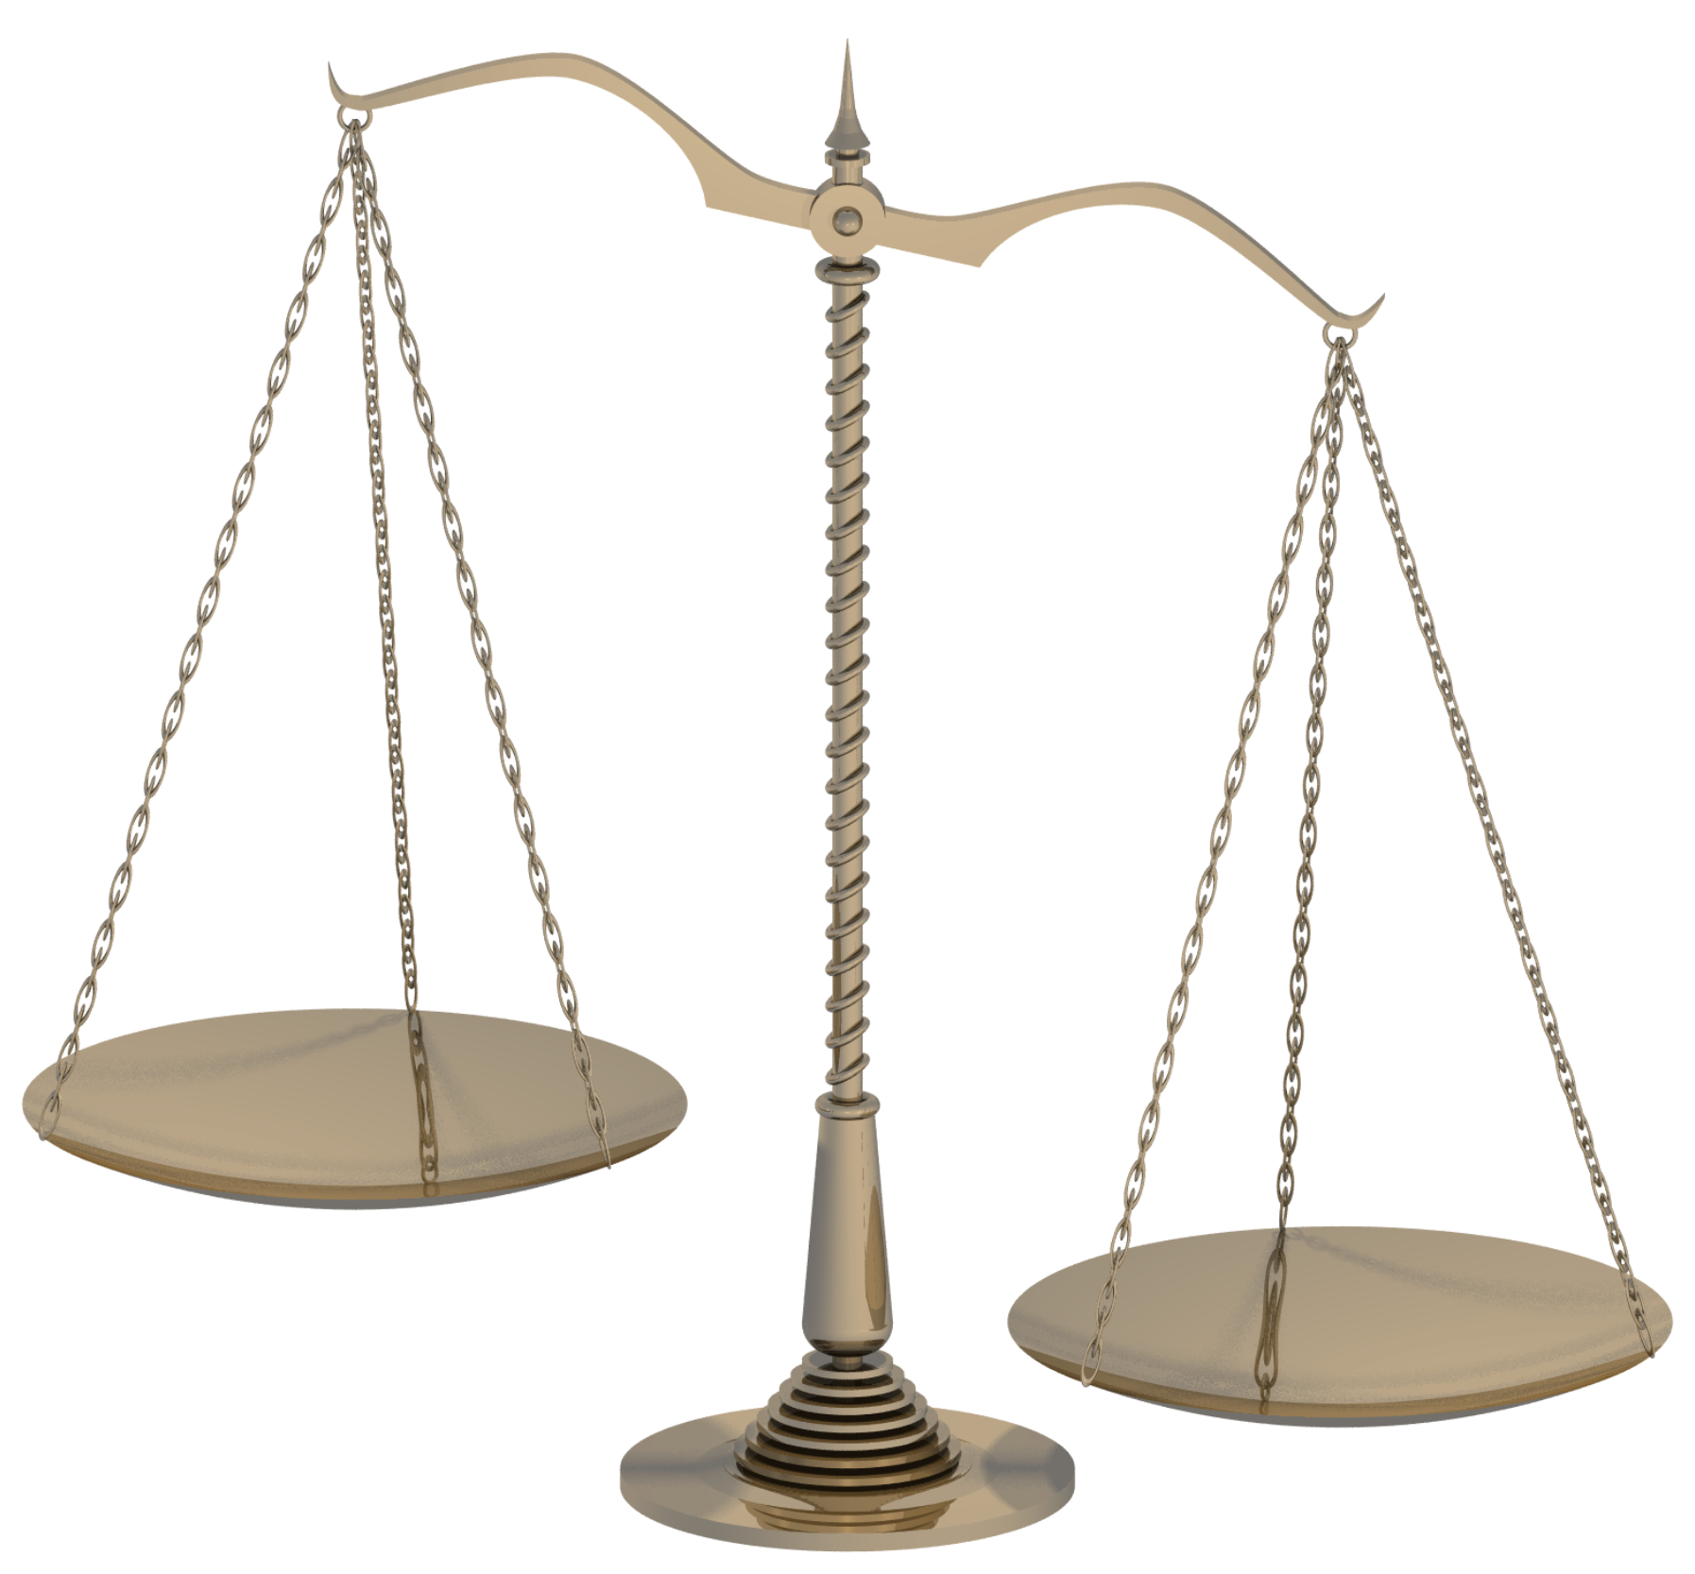
ADAPTING RADIATION TO IMMUNOTHERAPY
Adapting:
Radiation Fields
Radiation dose/fractionation
Blood as OAR
Sequencing
IT as a tool to
enhance RT response
RT as a tool
to integrate with IT
- Relevance to pancreatic cancer

Slide 6
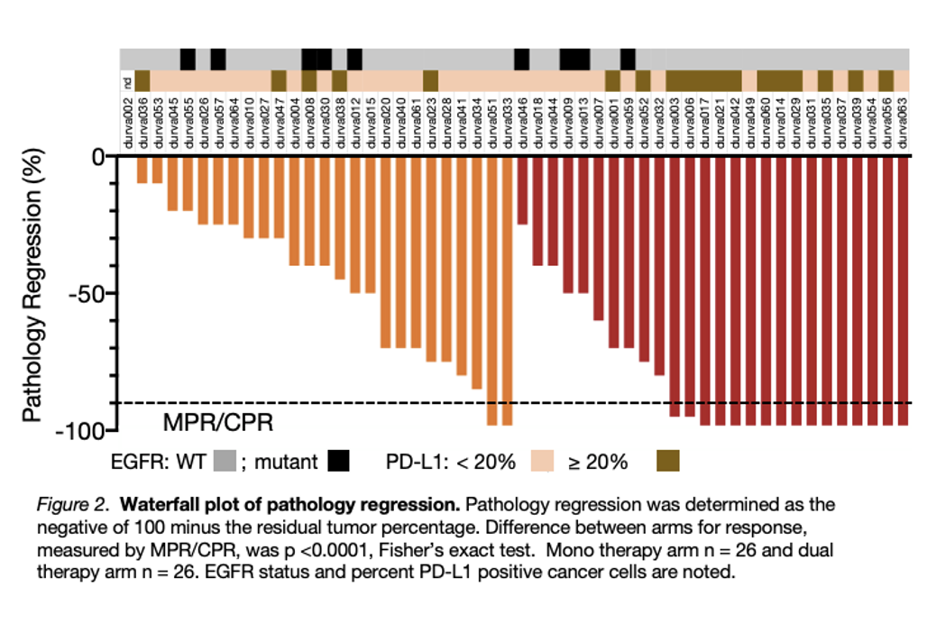
A prospective randomized trial of IT versus IT+RT
RESULTS
Durva Durva+RT
Endpoints:
Safety
Clin response
Path response
DFS
Comparable toxicity between 2 arms
MPR: 6.7% versus 53.3% (p<0.001)
(For EGFR negative: 8% (2/25) versus 75% (15/23)
(Lancet Oncology, 2021)

Slide 7
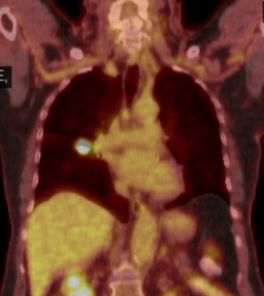
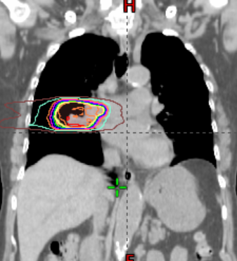

Path response of positive nodes (only primary irradiated)
13 pts had pN+ pre-tx
MPR
Durva: 1/7 (14%)
Durva/RT: 4/6 (66%)
Should draining nodes be excluded when RT is used with ICB?
(Lancet Oncology, 2021)

Slide 8
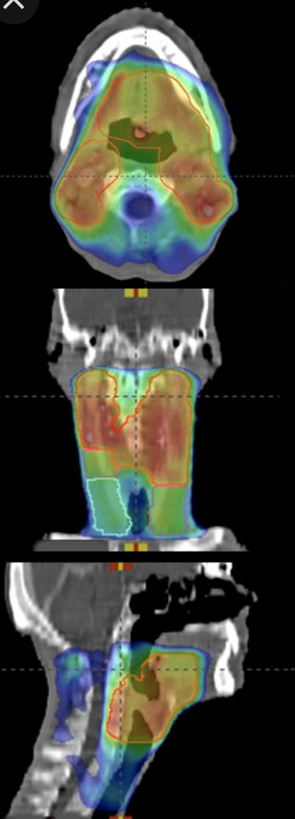
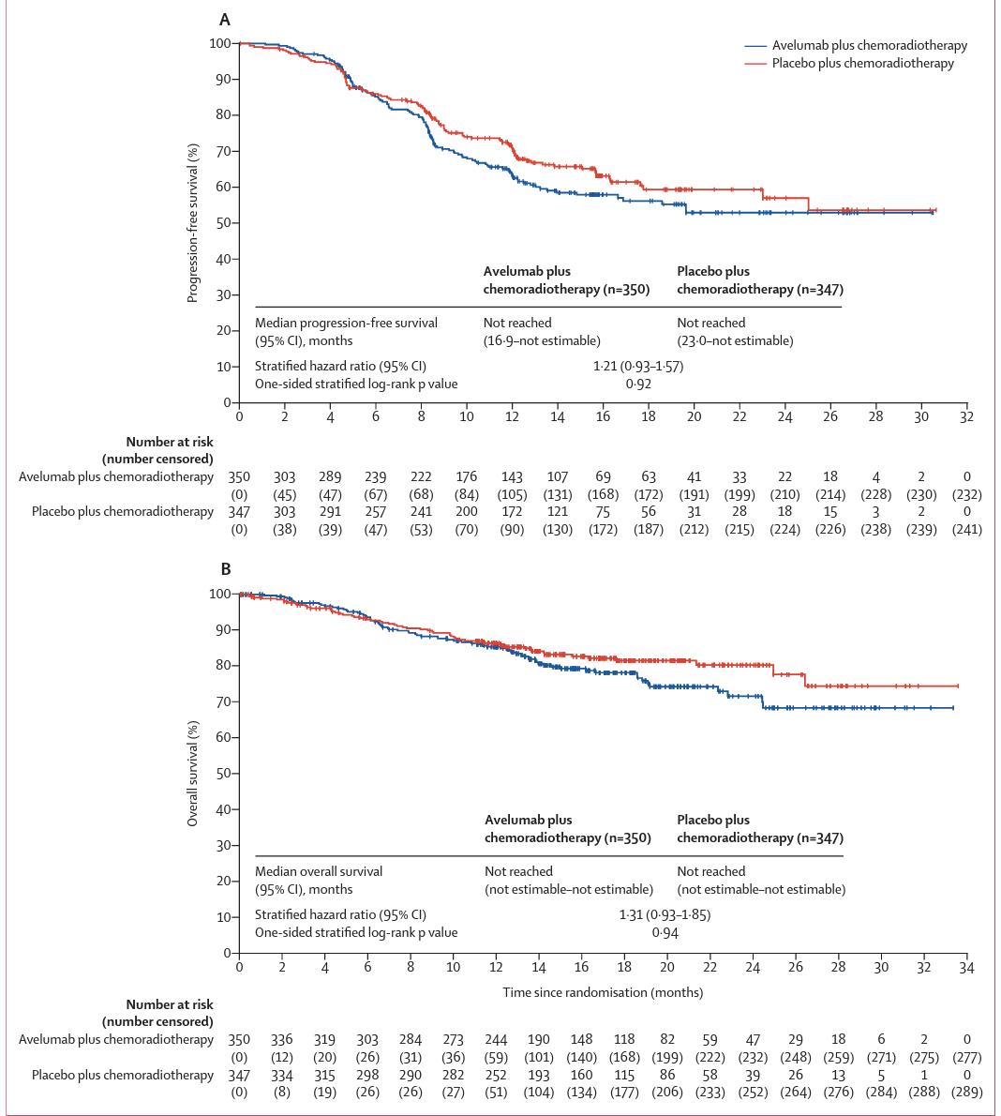
JAVELIN trial
Avelumab plus standard-of-care chemoradiotherapy versus chemoradiotherapy alone in patients with locally advanced squamous cell carcinoma of the head and neck: a randomised, double-blind, placebo-controlled, multicentre, phase 3 trial
70 Gy in 35 fractions, standard fields
chemoRT preceded by Avelumab
Lee N et al Lancet Oncology 2021: 22 (4)450-462

Slide 9
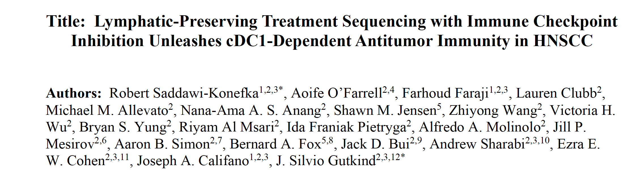
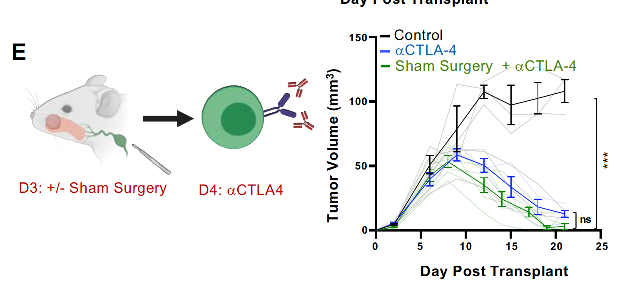
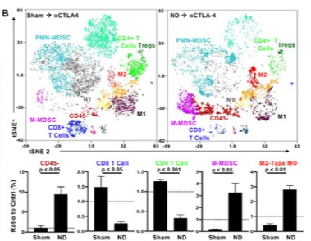
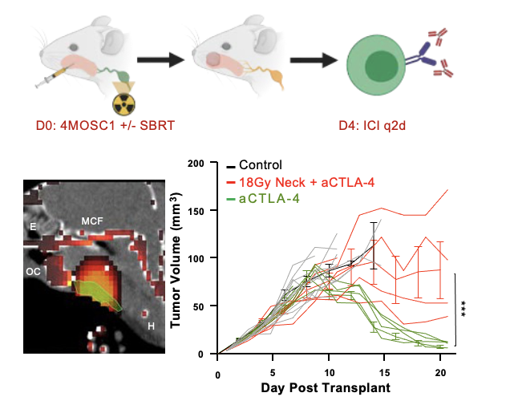
DAY 10: CyTOF of tongue tumors from animals subjected to node
dissections vs sham surgery, followed by anti-CTLA4
Saddawi-Konefka et al :bioRxiv preprint doi: https://doi.org/10.1101/2022.02.01.478744
Notes:
.Representative immunohistochemical images of 4MOSC1 tongue tumors from animals
subjected to neck dissection or sham surgery followed by ⍺CTLA-4 therapy, harvested at day
10. Robust immuninfiltrate in the tumor of sham surgery treated animals compared to nodal dissected ones
B. Representative tSNE plots shown from a time-of-flight mass cytometry (CyTOF)
Increase of CD45 negative cells in node dissected, with decrease of CD4/8 cells in the node dissected and increased MDSC and M2 macrophages

Slide 10
ADAPTING RADIATION TO ICB
Adapting:
Radiation Fields
Radiation dose/fractionation
Blood as OAR
Sequencing
ICB as a tool to
enhance RT response
RT as a tool
to integrate with ICB

Slide 11
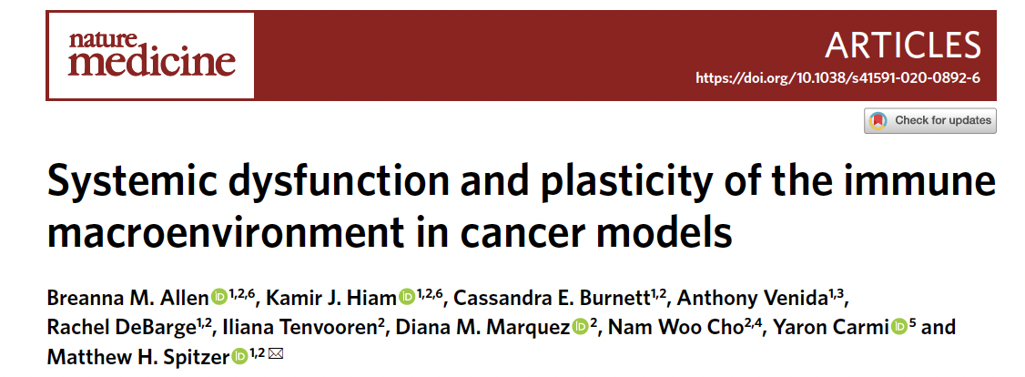
Surgical removal of primary tumor recovers systemic immunity
Other forms of ablation: radiotherapy, cryotherapy, radiofrequency, etc.

Slide 12
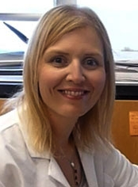

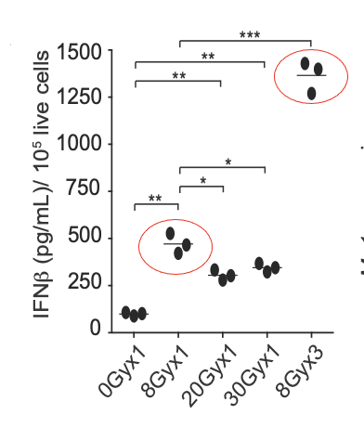
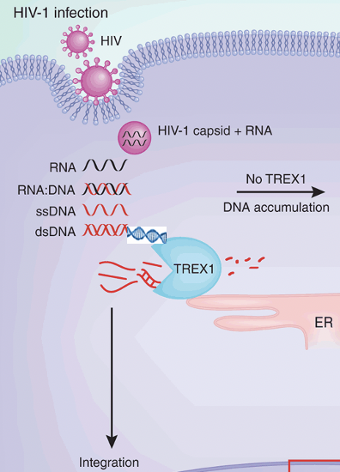

Dependence of radiation dose/fraction
P
IFN𝞫
RT
IRF3
NF𝞳b
Transcription
DNA breaks
Mutation
dsDNA
TREX1*
Vanpouille-Box et al.,
Nature Commun 2017
cGAS
DNA
RNA
P
P
A
IRF3
cGAMP
IRF3
G
cGAMP
Endoplasmic reticulum
STING
STING
TBK1
IRF3
cGAS
Teunis B H Geijtenbeek
Nature Immunology 11, 979–980 (2010)
Yamazaki et al., Nature Immunology 2020; Formenti et al., Nature Medicine, 2019

Slide 13
Subset analysis: 11 cases with matched biopsies, pre/post RT + pembrolizumab
For pancreatic cancer : SBRT, 8-10 Gy X 5
Luke et al., Clin Cancer Res 2020
Notes:
Thirty-five biopsies were obtained from 24 patients: 19 pre-SBRT and 16 post-SBRT (11 matched) prior to pembrolizumab and were analyzed via RNA microarray.
Pre and post-RT bx showing the upregulation of IR pathways post-RT and of interest upreg of TREX1 was associated with worse response – while the opposite was true for DNAse1 (which operates in the extracellular space) – an intriguing observation that needs F/U

Slide 14
ADAPTING RADIATION TO ICB
Adapting:
Radiation Fields
Radiation dose/fractionation
Blood as OAR
Sequencing
ICB as a tool to
enhance RT response
RT as a tool
to integrate with ICB

Slide 15
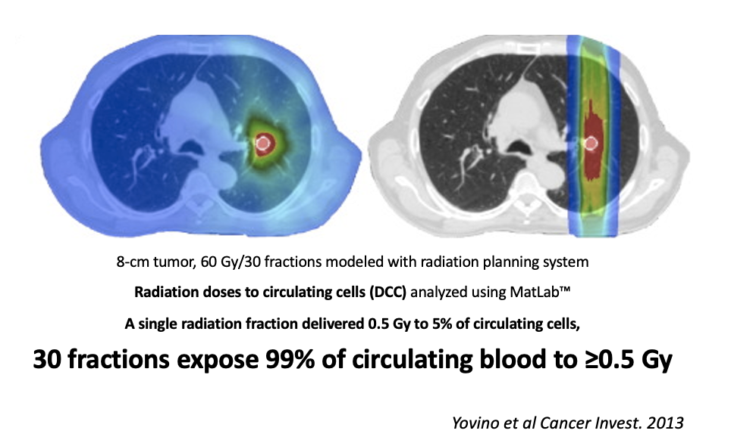
RT techniques and normal tissue exposure

Slide 16
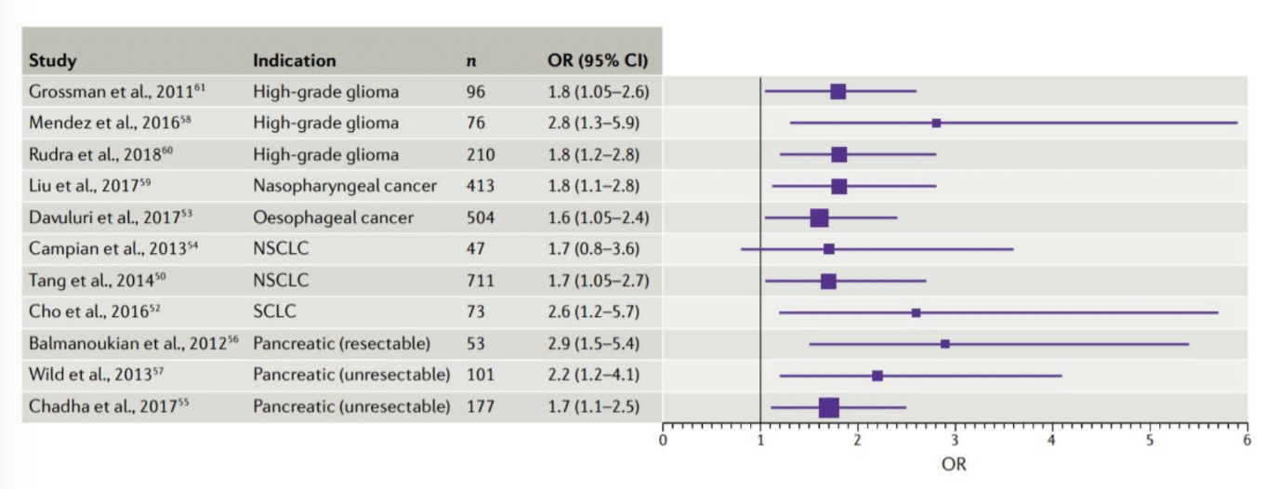
RT-induced lymphopenia is associated with poorer survival in multiple tumor types
Grassberger C et al. Nat Rev Cli Oncol 2019

Slide 17
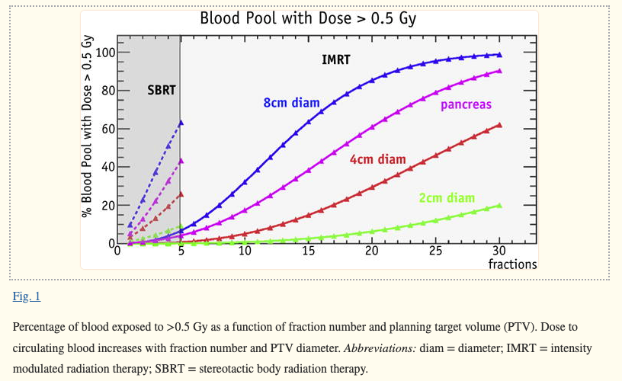
Lymphopenia in pancreas RT
Depends on:
number of fractions
field size
dose rate
WILD ET AL Int J Radiat Oncol Biol Phys. 2016 Mar 1; 94(3): 571–579.

Slide 18
ADAPTING RADIATION TO ICB
Adapting:
Radiation Fields
Radiation dose/fractionation
Blood as OAR
Sequencing
ICB as a tool to
enhance RT response
RT as a tool
to integrate with ICB

Slide 19
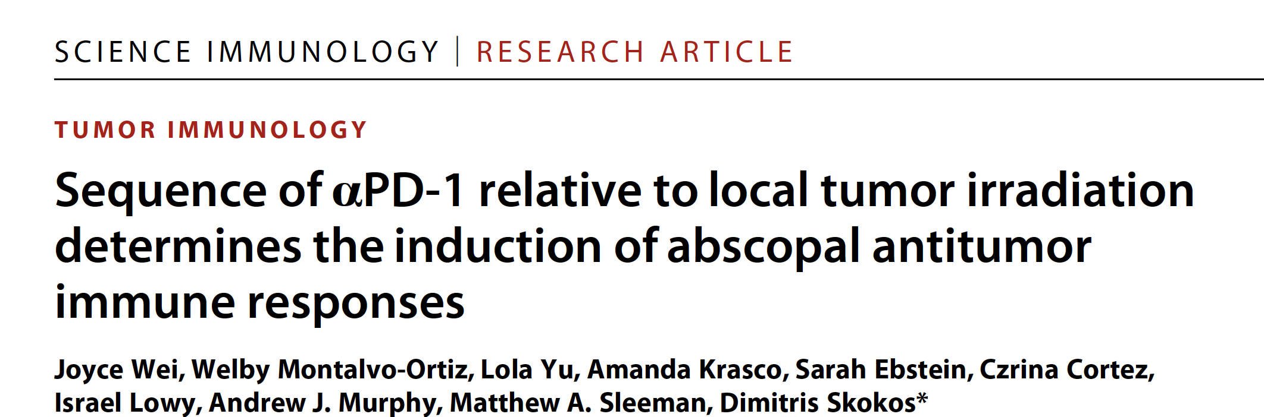
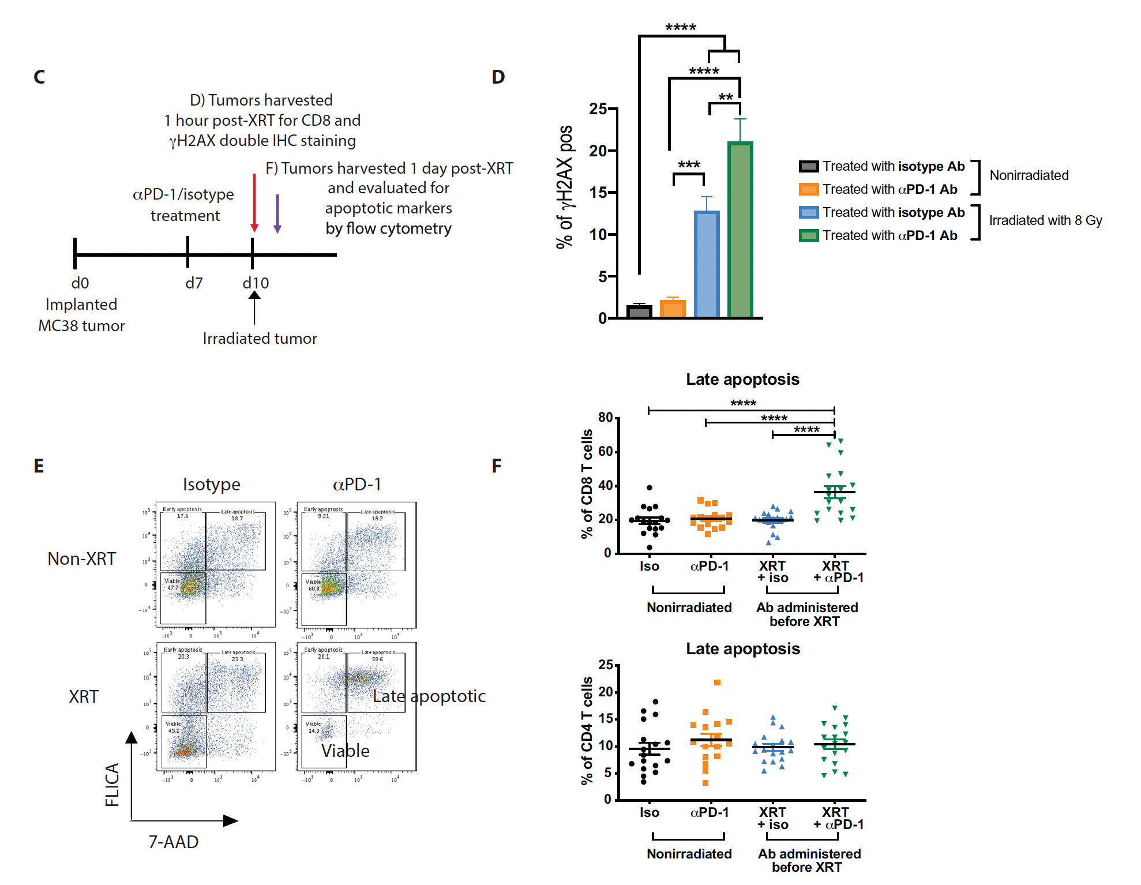
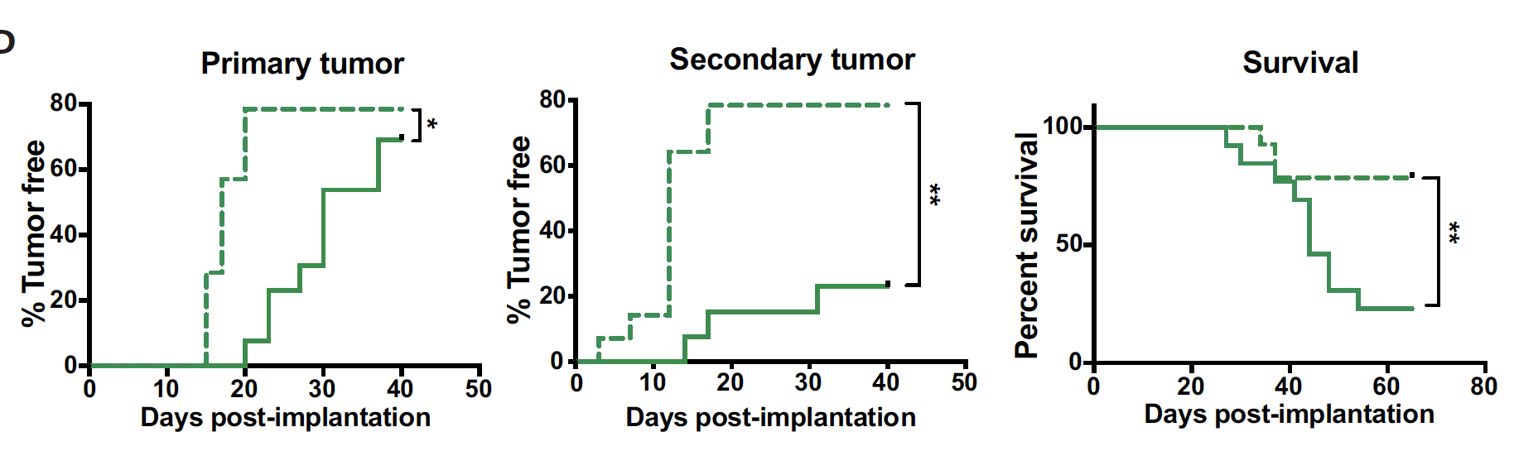
Anti PD-1 after versus before RT
Notes:
When Tcells are treated with anti-PD1 before RT you can see increased gamma H2AX), which marks double-stranded breaks as evidence of increased DNA damage.
the addition of anti PD-1 before irradiation significantly increased the percentage of intratumoral CD8+ T cells in late apoptosis in comparison with all other treatment groups: isotype control, anti PD-1, and radiation alone.

Slide 20
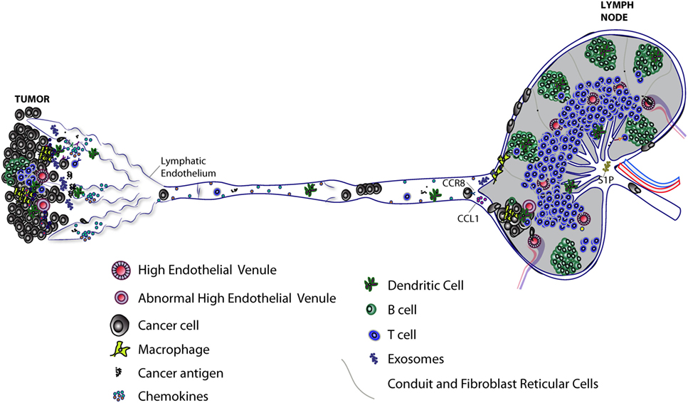
Suggested Paradigm:
RT to the tumor only, as a vaccination hub
SBRT
Day 1. SBRT to primary only, - small fields (3-5 fractions),
- excluding draining nodes
- limiting blood exposure
Day 8-15. Treat with anti PD-1/PDL-1 (last day of RT)
Day 15-60. Repeat 2-3 immunotherapy cycles
Day 40-60. Assess response at surgery: if persistent disease, complete nodal irradiation (delayed)
Relevance to pancreas

Slide 21
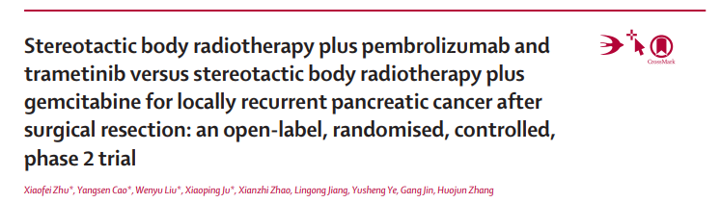
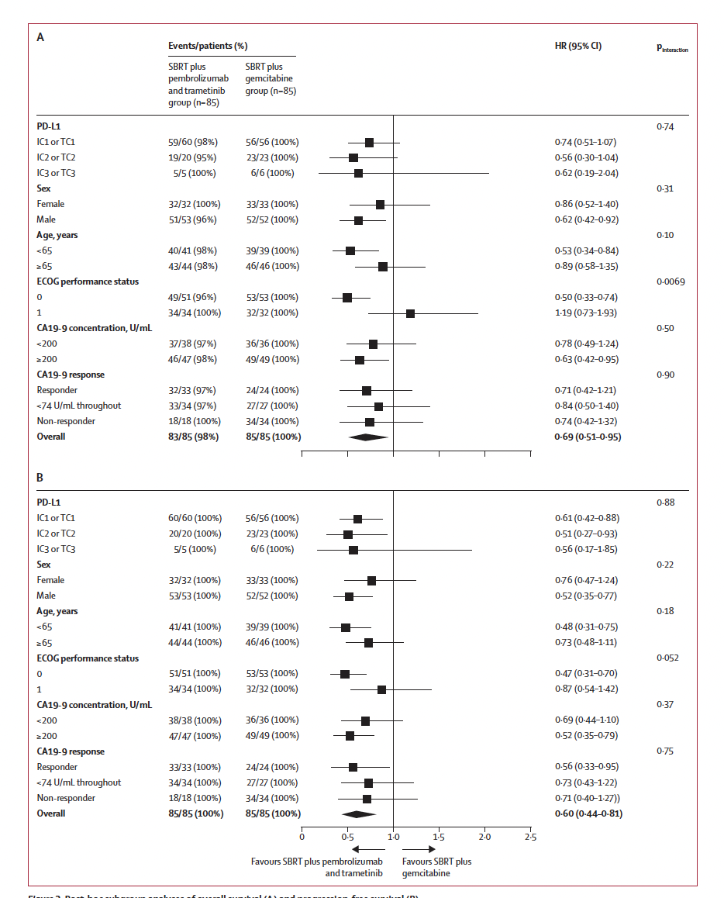
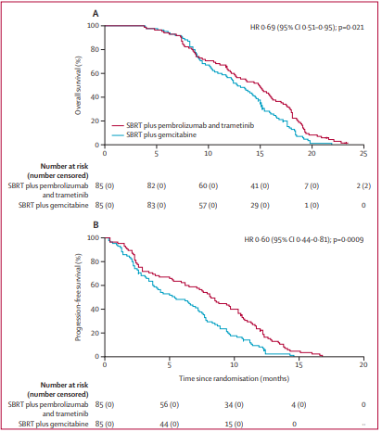
Pembrolizumab: 1 week after SBRT
SBRT: 7-8 Gy X 5
Can we improve these results?
Lancet Oncology 2021

Slide 22
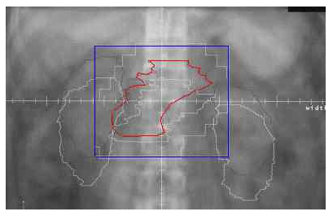
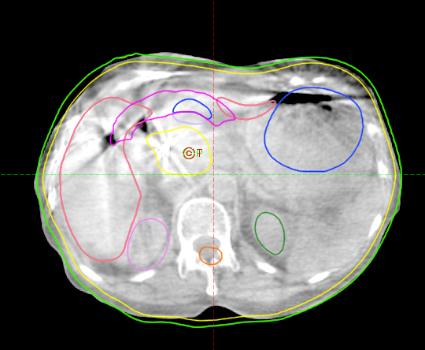
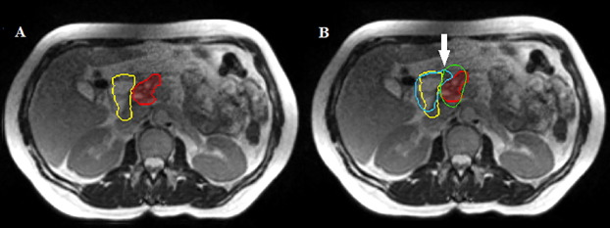
Motion management and imaging guidance have improved
The current primary challenge in pancreatic radiotherapy is delivering significant radiation doses to the target without causing significant toxicity
Red: GTV
Yellow: Duodenum baseline
Blue: Duodenum re-contoured
Green: 35 Gy isodose
Courtesy of Raldow

Slide 23
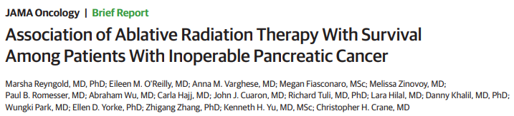
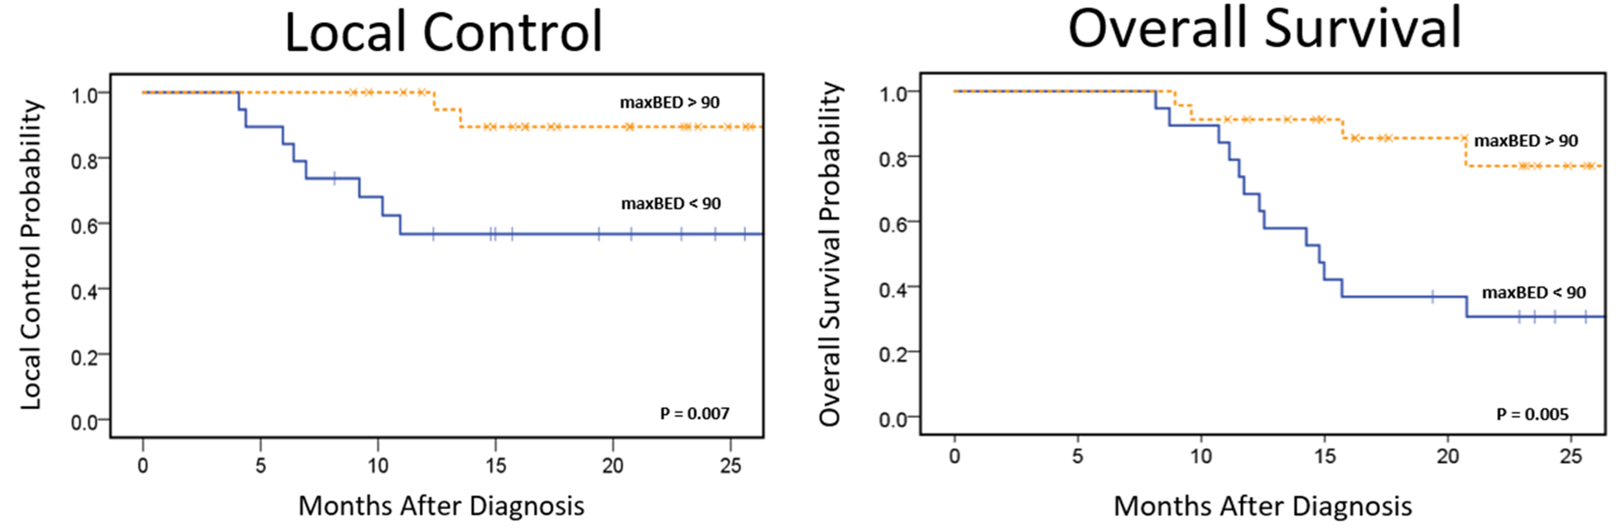
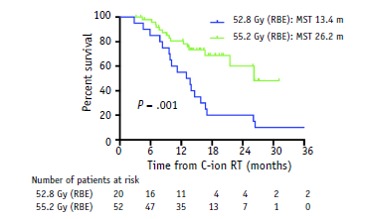
Higher radiation doses associated with better outcomes (multiple prospective studies)
P = 0.007
P = 0.005
Numerous studies around the world utilizing various escalated doses and modern techniques

Slide 24
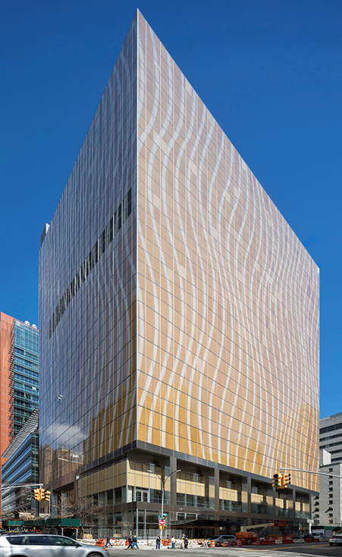
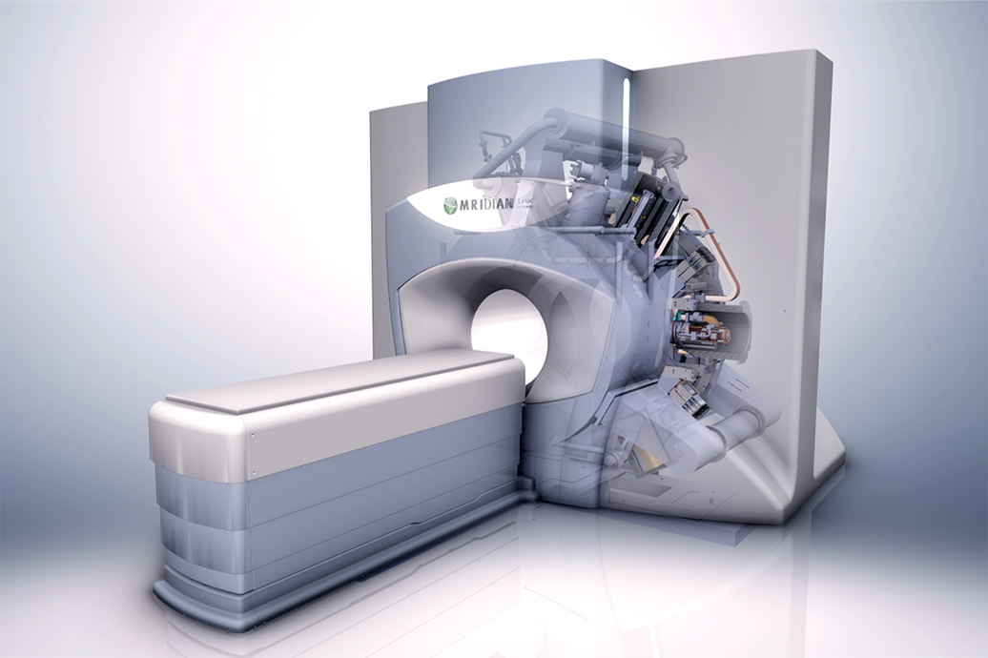


SMART Radiation Therapy in Pancreatic Cancer: Ablative Treatment with Less Toxicity
First MRI-Linac in New York and Northeast Region.
One of the first MRI-Linacs in the world (one of the first 5).
Advantages are particularly suited for pancreatic radiotherapy.

Slide 25
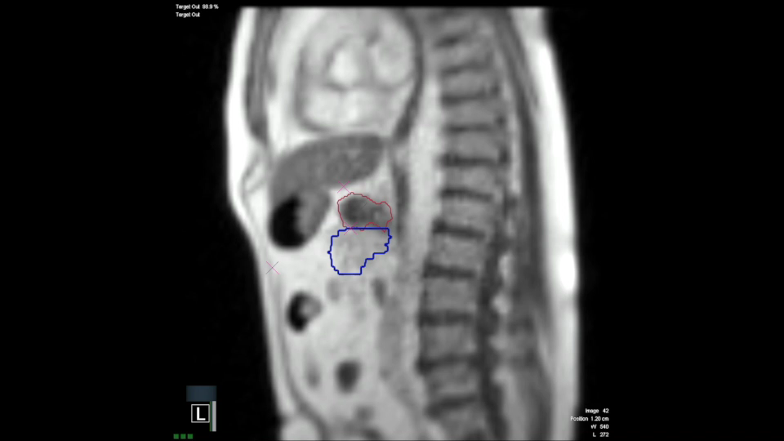
MRI guidance enables gated radiation delivery based on continuous organ visualization
INTRA FRACTION
Superior
Heart
Liver
Anterior
Stomach
Pancreatic Tumor
Posterior
Radiation Target
Bowel Loops
Inferior

Slide 26
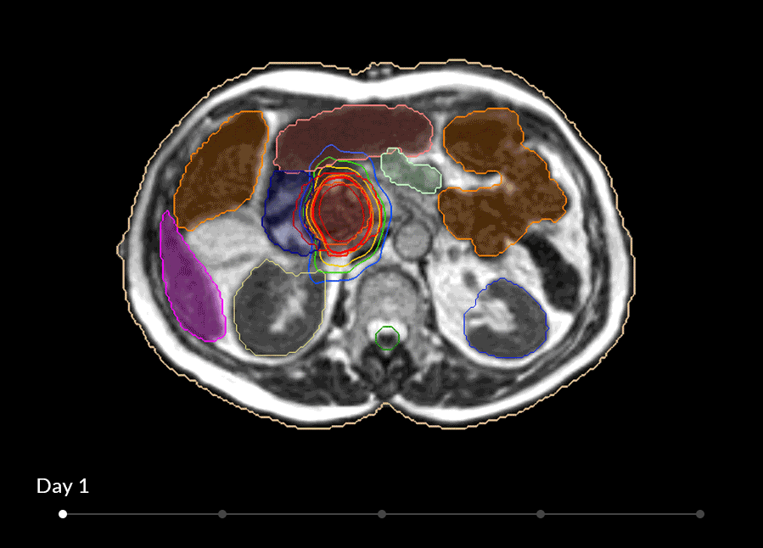
The anatomy around the pancreas changes significantly day to day
INTERFRACTION
SMART
A multi-institutional Clinical Trial
(completed accrual)
Inoperable pancreatic cancer
After at least 3 m chemo
50 Gy in 5 fractions
MR- guided adaptive SBRT

Slide 27
Conclusions
Combination with immunotherapy is required to unleash the immunogenicity of radiation therapy
Adapting radiation prescriptions/techniques is required to synergize with immunotherapy, to sustain host’s immune fitness
A regimen of focalized hypo-fractionated radiation directed to the tumor only should be given first, followed by anti-PD1/PD-L1

Slide 28

RADIATION & IMMUNITY PROGRAM
Lorenzo Galluzzi
Takahiro Yamazaki
Ai Sato
Marissa Friedman
Giulia Petroni
Norma Bloy
Silvia C. Formenti
Encouse Golden
Josephine Kang
Andrew Brandmeier
Ariel Marciscano
John Ng
Himanshu Nagar
J. Keith Dewyngaert
Laura Santambrogio
Cristina Clement
Sangeetha Thangaswamy
Zohaib Khan
Jaspreet Osan
Madhur Shetty
Aitziber Boque'-Martinez
Sandra Demaria
Sheila Spada
Maud Charpentier
Samantha Van Nest
Ines Mota
OUR PATIENTS
Claire Vanpouille-Box
Mara De Martino
Clinical Trials Core
Maria Fenton-Kerimian
Sharanya Chandrasekhar
Pragya Yadav
Charles Ekeh
WCM Biostatistics & Epidemiology
Xi Kathy Zhou , Karla Ballman
Preclinical Core
Ariel Marciscano
Gabor Jozsef
Karsten Pilones
Camille Daviaud
Jeffrey Kraynak
Yasmeen Sarfraz
FUNDING
DOD BC180476 / W81XWH-19-1-0101
DOD BC180595 / W81XWH-19-1-0141
DOD W81XWH-20-BCRP-TBCCA
Breast Cancer Research Foundation
Ziskin Award

